Slide 1
Web fundamentals project
The first checkpoint

Slide 2
Table of Contents
01
02
03
How does the web works?
What do you need to be a web developer?
What’s the role of a web developer.

Slide 3
01
THE WEB

Slide 4
Our Company
Your logo
Mercury is the closest planet to the sun and the smallest one in the solar system—it’s only a bit larger than the Moon. The planet’s name has nothing to do with the liquid metal, since Mercury was named after the Roman messenger god

Slide 5
How does the web works?
Neptune
Mercury
Jupiter
Neptune is the farthest planet from the Sun
Mercury is the smallest planet in the Solar System
Jupiter is the biggest planet in the Solar System

Slide 6
Our Solutions
Mercury
Venus
01
02
Mercury is the closest planet to the sun
Venus is the second planet from the sun
Jupiter
Neptune
03
04
Jupiter is the biggest planet of them all
Neptune is the farthest planet from the Sun

Slide 7
Our Consultants
John James
Venus is the second planet from the Sun
Jane Patterson
Joe Doe
Mercury is the closest planet to the Sun
Neptune is the farthest planet from the Sun

Slide 8
Our Partners
Mercury
Jupiter
Neptune
Mercury is the closest planet to the Sun
Jupiter is the biggest planet of them all
Neptune is the farthest planet from the Sun
Saturn
Mars
Venus
Saturn is the ringed one and a gas giant
Despite being red, Mars is actually a cold place
Venus is the second planet from the Sun

Slide 9
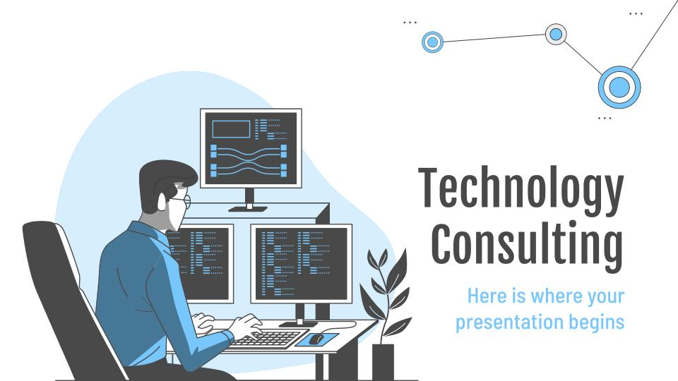
Desktop Software
You can replace the image on
the screen with your own
work. Just delete this one,
add yours and center it properly

Slide 10
Thanks!
Do you have any questions?
youremail@freepik.com
+91 620 421 838
yourcompany.com
Please keep this slide for attribution

Slide 11


